Slide 1

Crypto & Stock Sentiment
Zac Damian Neya

Slide 2
Before analysis
Risk Profile Ticker
Risk Profile Ticker
Minimal Risk
Maximum
Maximum Risk
Maximum Risk
Maximum Risk
Maximum Risk
Minimal Risk stocks have favorable sentiment.
Maximum Risk stocks/ETFs will have negative/less favorable sentiment.

Slide 3
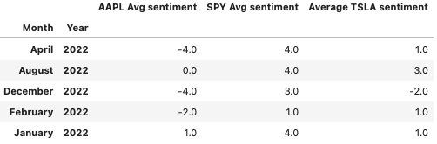
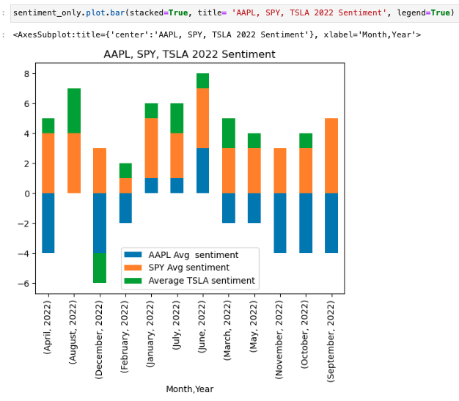
Stock Sentiment
AAPL total avg sentiment = -2
SPY total avg sentiment = 3
TSLA total avg sentiment = 0

Slide 4
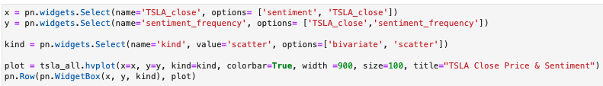
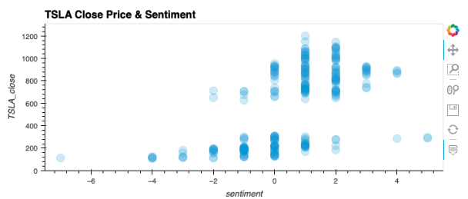
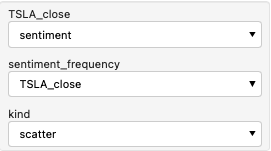
TSLA
The highest sentiment was during TSLA
stock split.
Lowest sentiment – Jan 2023.

Slide 5
Risk & Sentiment
Findings After Analysis:
Sentiment Analysis can be used as a technical trigger to invest or purchase options contracts.
Minimal Risk stocks have less favorable market sentiment.
Maximum Risk stocks have high sentiment.
Risk Profile Ticker
Minimal Risk AAPL
Maximum ADA
Maximum Risk BTC
Maximum Risk ETH
Maximum Risk SPY
Maximum Risk TSLA

Slide 6
Resource
Neya’s resources
https://codelabs.developers.google.com/codelabs/cloud-natural-language-python3#7
Gcloud Google Cloud: https://console.cloud.google.com/apis/library?project=sentimentandrisk&cloudshell=true
Sentiment data – RTAT nasdaq reports. https://docs.data.nasdaq.com
Plots: https://hvplot.holoviz.org/user_guide/Timeseries_Data.html
News: https://alpaca.markets/docs/market-data/news/

